Slide 1


Predicting Customer Behaviour Using KDD Cup 2009 Small Dataset With A Variety of Classifiers
IMAT 5234 Applied Computational Intelligence
School of Computer Science and Informatics
Jon-Paul Boyd & Henry Lidgley
5th May 2018

Slide 2
Introduction – The KDD Cup 2009 Challenge – What & Why
“Predict the propensity of customers to switch provider (churn), buy new products or services (appetency), or buy upgrades or add-ons proposed to them (up-selling)” [1]
Relevant classification problem in that understanding customer behaviour is critical to optimisation of marketing strategy with effort and budget focused on the most valuable or at-risk customers
Availability of a real-world, noisy and unbalanced dataset from French telecom giant Orange gives added incentive
An opportunity to learn from working through several interesting data science and machine learning technical challenges, including data preparation, modelling classifiers, hyperparameter tuning and performance evaluation
Can evaluate classifier performance, comparing results against KDD benchmark and submission entries including from IBM/University of Melbourne
We follow the same predictive model evaluation criteria stipulated in 2009, that being an evaluation using Receiver Operating Characteristic (ROC) Area Under Curve (AUC) score, a common method to “accurately evaluate the performance of a system that learns by being shown labelled example” [2]
Boyd covers the approach with a focus on tree-based classifiers
Lidgley details the neural networks solution
JPB
Notes:
The ROC curve is a plot of the true positive rate (sensitivity) against the false positive rate (specificity) for the different possible cutpoints of a diagnostic test. In effect, it measures the accuracy of prediction probabilities for every possible decision threshold that can be used to round probabilities to binary predictions. AUC scores can range between 0 and 1, with the higher the value the more accurate the model’s predictions.
As a benchmark, the challenge included AUC scores from a basic naïve bayes classifier for competitors to beat in order to qualify for a prize [1]. The overall AUC benchmark score is 0.6711 (Churn problem: AUC = 0.6468; Appetency problem: AUC = 0.6453; Up-selling problem: AUC = 0.7211).

Slide 3
Dataset Analysis Highlights and Challenges
50000 observations with 230 features
No feature labels so no opportunity to leverage any level of domain expertise or insight
Data is scrambled and randomised
Positive target labels sparse for predictive tasks – 7% for churn, 1.8% for appetency and 7.4% for upselling
18 features have no data
5 features have constant unary value (and therefore no predictive value)
150 features have > 95% observations with no data
Number of unique values for categorical features ranges from 1 to 15413
JPB
Notes:
Positive target binary values were very sparse, with only 7.34% (3672) of observations labelled positively for churn, 1.78% (890) for appetency and 7.36% (3682) for upselling.

Slide 4
Tree-based Classifier Solution – Aims and Objectives
Predict 3 binary target variables with decision trees & ensembles of trees leveraging supervised learning with target labels
Sub Objectives
RQ1 Feasibility - Can a competitive solution be fielded by a non data scientist/statistician with no budget?
H1 Discover available open source classifiers with KDD Cup scoring performance “out of box”
RQ2 Performance - Can tree-based classifiers predict targets?
H2 Determine the importance of data preparation on tree-based classifier predictive performance
H3 Determine if predictive performance increases with bagging and further with boosting
H4 Ascertain if classifier tuning leads to improved predictive performance
H5 Determine if a tree-based classifier AUC score average can beat the KDD Cup benchmark
H6 Determine if a tree-based classifier AUC score average can rank at least mid-table
Research Instrument
Empirical AUC score measurements collected from the classifier development and test framework
JPB
Notes:
RQ1 H1 will be measured by ranking the baseline AUC scores of classifiers against KDD Cup benchmark and existing KDD Cup submissions “Full Results: Slow Track” [4]. Baseline means classifier with full default settings (no tuning applied).
RQ2 H2 is measured by comparing classifier baseline AUC scores when a variety of data preparation methods are applied.
RQ2 H3 will compare the predictive performance of each classifier to determine if “Boosting > Bagging > Single Tree” as stated by Leo Breiman still holds true (and quoted by Trevor Hastie at a Stanford University talk in 2003 [5]).
RQ2 H4 will compare the baseline AUC scoring of each classifier with corresponding final score after hyperparameter tuning applied.
RQ2 H5 will be measured by ranking the AUC scores of hyperparameter tuned classifiers against KDD benchmarks.
RQ2 H6 will be measured by ranking the AUC scores of hyperparameter tuned classifiers against existing KDD submissions “Full Results: Slow Track” [4].

Slide 5
Tree-based Classifier Solution – Key Features
Multi classifier analysis with decision tree, random forest, gradient boosting, AdaBoost, bagging and voting classifiers
Highly configurable runtime environment maintaining arguments enables only default or tuned models to be executed, or alternatively only grid search and scoring of hyperparameter permutations, for any combination of target variable classifier
Multiple dataset preparation profiles aids exploration data transformation approaches and effect on predictive performance
Visualization built in for graphical illustration of dataset features, data preparation methods and classifier scoring
Extensive file system logging of classifier feature importance, scoring and hyperparameter tuning results
JPB

Slide 6


Tree-based Classifier Solution – Key Custom Modules
The main module responsible for orchestrating the overall solution according to runtime environment settings
The file handler module for saving/loading of datasets and target variable files, output of scoring and feature importance data
The pre-processor module for data wrangling - imputation of null values, feature dropping, label encoding, one hot encoding
The modeler module scores baseline and final variants of each classifier. Includes hyperparameter scoring
The visualizer module graphs key stages in process, including dataset feature nullity, feature correlation and classifier scoring
Developed using Python, with classifiers from the sklearn module and data wrangling using the pandas module
JPB
Notes:
The main module responsible for orchestrating the overall solution according to runtime environment settings.
The file handler module takes care of saving/loading of datasets and target variable files, in addition to output of scoring and feature importance data.
The pre-processor module is responsible for data wrangling, with imputation of null values, feature dropping, label encoding and one hot encoding.
The modeler module scores the baseline and final variant of each classifier. The module includes hyperparameter scoring on an individual and combination parameter basis.
The visualizer module graphs key stages within the classification process that includes dataset feature nullity, feature correlation and classifier scoring.

Slide 7
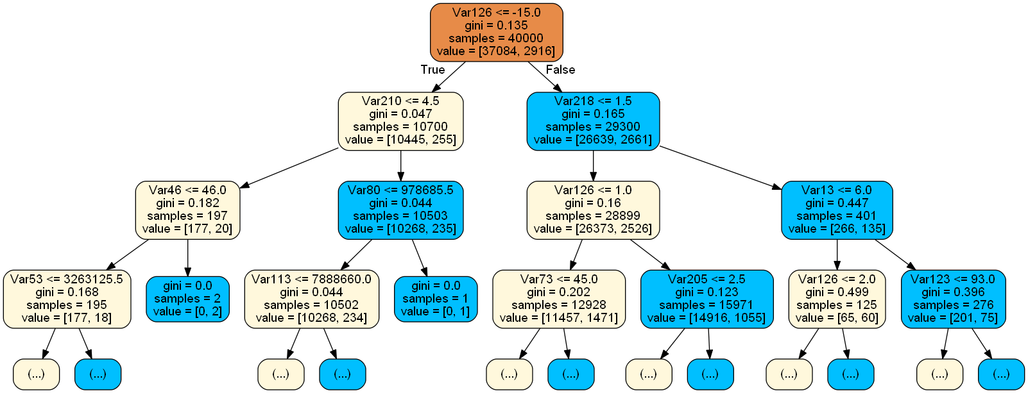
Tree-based Classifier Solution – The Classifiers
Decision Tree a divide and conquer approach, splitting dataset left and right according to questions asked. “Algorithms developed for learning decision trees represent a good compromise between comprehensibility, accuracy and efficiency” [3]
Random Forest uses D.T. classifiers as “weak” base learners. “Forest” from algorithm’s use of multiple decision trees, “random” as each tree works on random subset of observations and features to make class predictions. Aggregation of each decision tree observation binary classification determines final prediction, known as majority voting. “It grows a forest of random decision trees on bagged samples showing excellent results comparable with the best known classifiers” [17]
Bagging an ensemble method randomly sampling data into multiple weak base learners, in this case decision trees
AdaBoost another D.T. ensemble “calls a given weak or base learning algorithm repeatedly in a series of rounds. Initially, all weights are set equally, but on each round, the weights of incorrectly classified examples are increased so that the weak learner is forced to focus on the hard examples in the training set” [4]
Gradient Boosting like Random Forest, classification probability from each tree is averaged but boosting comes from a method
JPB
that re-weights at each step to resolve deficiencies from prediction errors in previous tree steps, and hence the ensemble is grown in an adaptive fashion. Described by Friedman as “competitive, highly robust, interpretable procedures for both regression and classification, especially appropriate for mining less than clean data” [18]
Voting ensemble classifier of other classifiers, in this study includes bagging, random forest and gradient boosting

Slide 8
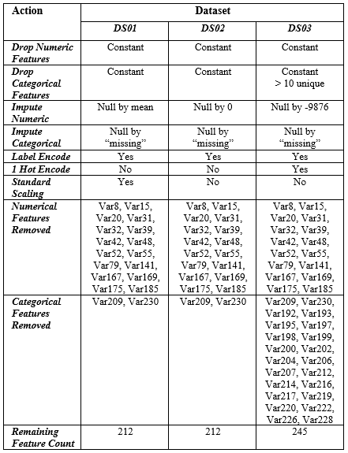
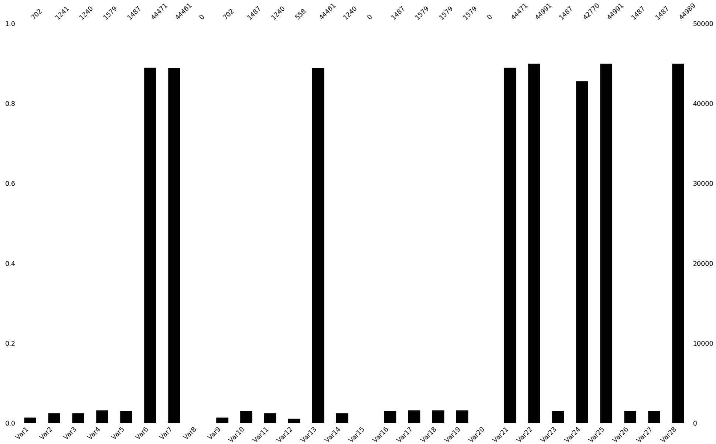
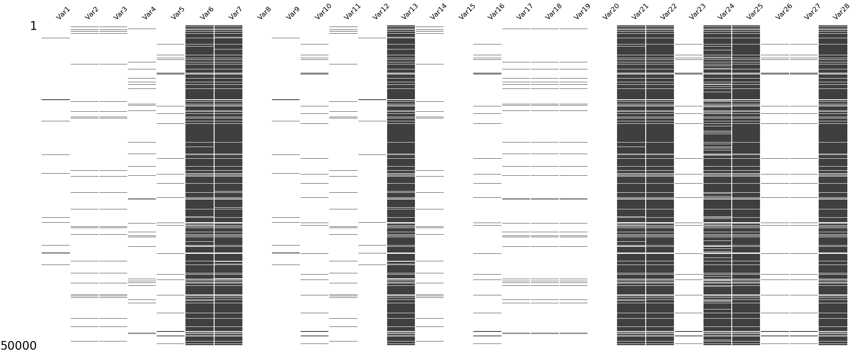
Tree-based Classifier Solution – Data Analysis and Preparation
Initial data exploration finds 5 features with constant value, number of unique features ranging from 1 to 15413, 18 features completely without data, 150 features with > 95% observations with no data. Fig. 1 represents data available for features, with Var1 having data for only 702 of total 50000 observations
Nullity Matrix Graph Fig. 2 shows overview of data density across all 50000 observations. Illustrates features like Var1 in leftmost column have very little recorded data as represented by majority whitespace. Also illustrates patterns, for example correlated variables in Var21 and Var24 where blocks of black (data) and white (no data) are comparable
JPB
Dataset Preparation Strategies summarized in Table 1. Includes numerical and categorical feature imputation, label encoding, one hot encoding and scaling. Strategies determined after exhaustive permutation testing, including incremental setting of feature value thresholds, then scored with baseline classifiers to benchmark them
Table 1. Dataset Preparation Strategies
Fig. 1. Nullity comparison count by column for first 28 features
Fig. 2. Nullity matrix of first 28 numerical features
Notes:
Experimentation in configurating the classification model to only use the top 20 features could not yield improved predictive performance in AUC scoring.

Slide 9
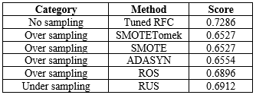
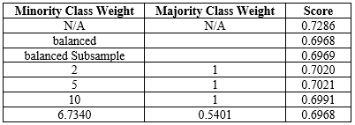

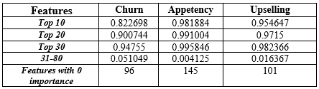
Tree-based Classifier Solution – Additional Preparation Tests
JPB
Sampling dataset extremely unbalanced with all 3 positive behaviours in the minority class (churn 7.34%, appetency 1.78%, upselling 7.36%), experimentations on oversampling minority class and under sampling majority class in observations within the training set using tuned random forest. Unfortunately only performance degradation compared with “no sampling” test observed. Table 2 compares sampling method results
Weighting further attempt to address class imbalance using random forest hyperparameter class_weight with range of weighting schemes. The weighted models suffered significant AUC score performance degradation compared with non-weighted model, as shown in Table 3
Classification Thresholds sklearn default threshold set at 0.5 for positive binary classification. Confusion matrix computed to represent the classification types and error rate of model with adjusted thresholds as shown Table 4. Real-world scenario would consider threshold adjustment for true positive identification over AUC score
Feature Importance table 5 presents combined importance for a range of groupings. Top 20 features account for 0.9 importance for churn, 0.99 for appetency and 0.97 for upselling. A combined 50 features ranked 31-80 provide very little especially for appetency and upselling, demonstrating the noise of this dataset
Table 2. Comparison of sampling methods
Table 3. Comparison weighting methods with RF
Table 4. CM and threshold tests
Table 5. Combined feature importance weightings

Slide 10
Tree-based Classifier Solution – Classifier Build, Score and Tune
JPB
Import python classes enables instantiation of classifier. GridSearchCV supports classifier tuning. Roc_auc_score returns an AUC score when passed model predictions and target labels
Instantiate classifier which can then be scored. Baseline configuration shown in example. Final model instantiates with collection of best hyperparameter values.
Train model with fitted dataset, predict then score, fitting the passed classifier to the independent training partition features and dependant target labels. Prediction probabilities are then made and AUC scored, comparing known labels vs predicted.
Tuning templates with predefined parameter values iteratively refined during build and test
Testing a broad range of hyperparameter values with the template grid_search enhanced with a range of values for specific parameters which are scored to find best predictive performance
from sklearn.ensemble import RandomForestClassifier
from sklearn.model_selection import GridSearchCV
from sklearn.metrics import roc_auc_score
def score_baseline_rfc(envparm, filehandler,):
clf = RandomForestClassifier(random_state=20)
fit_predict_score(clf, rfcname, self.rfc, 'Baseline', envparm)
def fit_predict_score(clf, clf_name, clf_name_short, gs_param, envparm):
clf.fit(dataset_train, target_train)
predict = clf.predict_proba(dataset_test)[:,1]
score_auc = roc_auc_score(target_test, predict)
def get_gridsearch_single_abc(param_grid):
grid_search = GridSearchCV(
estimator=AdaBoostClassifier(
DecisionTreeClassifier(
random_state=20,
criterion='gini',
max_depth=5,
max_leaf_nodes=20,
min_samples_leaf=44,
min_samples_split=46),
random_state=20, n_estimators=500),
param_grid=param_grid, scoring='roc_auc',
n_jobs=8, iid=False, cv=3, verbose=0)
return grid_search
def gridsearch_single_abc():
gs_param = 'n_estimators'
param_grid = {gs_param: range(50, 1550, 50)}
grid_search = get_gridsearch_single_abc(param_grid)
fit_predict_score(grid_search, abcname, gs_param)
gs_param = 'learning_rate'
param_grid = {gs_param: [0.1, 0.2, 0.5, 1.0]}
grid_search = self.get_gridsearch_single_abc(param_grid)
fit_predict_score(grid_search, abcname, abc, gs_param)

Slide 11
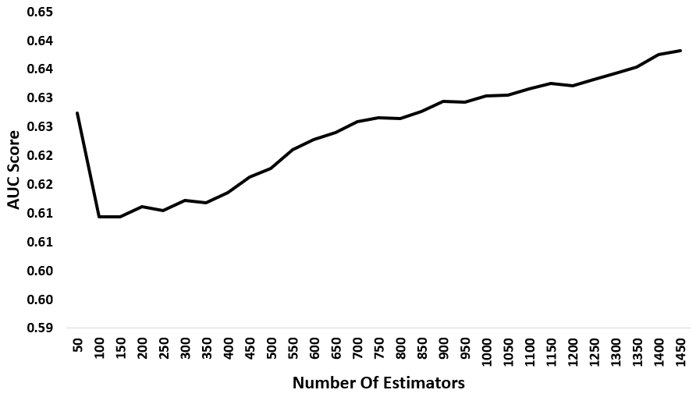
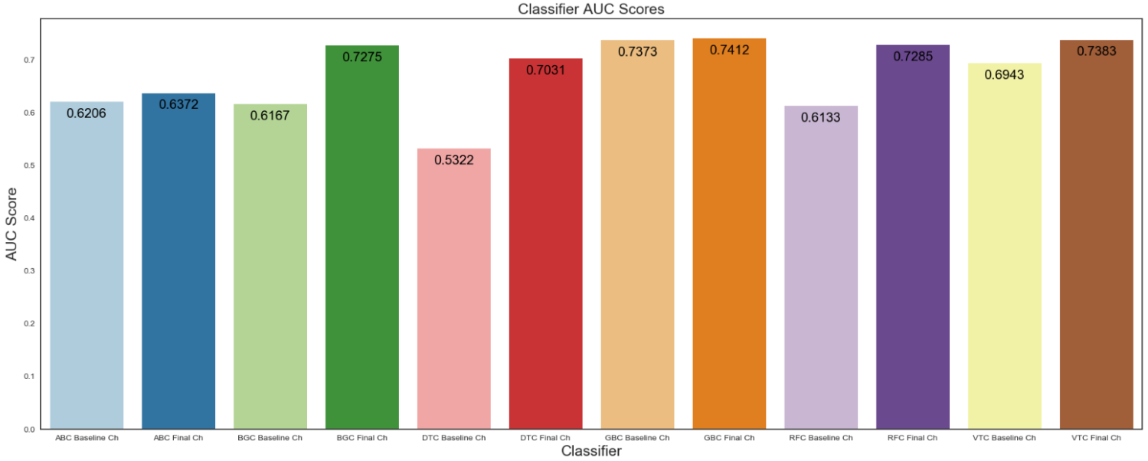
Tree-based Classifier Solution – Classifier Tuning Continued
JPB
Tuning Single Hyperparameters Fig. 3 presents output from GridSearchCV scoring of the AdaBoost classifier predicting churn using DS02, with a range of values for hyperparameter n_estimator (number of tree base learners grown). AUC score tapers off at 1450 trees with score of 0.6382. Interestingly, 50 trees returns a score of 0.6273 then sharply drops, only surpassed when using 850 trees and above. For information baseline configuration score was 0.6205.
Baseline Vs Final Tuned Fig. 4 shows difference between baseline vs tuned scores for churn. All models respond positively to tuning, the greatest increase over baseline configuration score with the decision tree classifier (0.1709), demonstrating its receptiveness to tuning. There are some surprises, with AdaBoost registering unexpectedly poor performance, being surpassed by decision trees and random forest. Gradient boosting shows minimal improvement of just 0.0039, underlining just how strong this classifier is “out of box” with well optimised default settings and beating voting.
Table 4 – Classifier final prediction AUC scores
Fig. 3. AdaBoost churn AUC score with number of estimators
Fig. 4. Classifier baseline vs final tuned, predicting churn (dataset DS02)

Slide 12
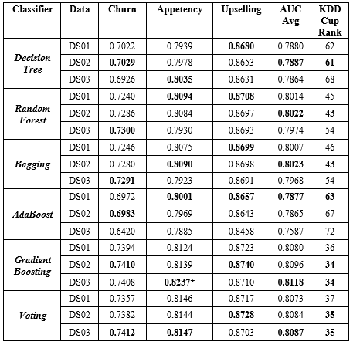
Tree-based Classifier Solution – Evaluation
JPB
Final classifier results presented in table 6
Best performing experiment variant is gradient boosting consuming DS03, scoring AUC average of 0.8118, ranking 34th of 89 total challenge submissions. Hypothesis H1 (out of box), H5 (beat KDD benchmark) and H6 (rank minimum mid-table) confirmed. Voting classifier comes second, ranking 35th, followed by bagging (43rd), random forest (43rd), decision trees (61st) and AdaBoost(63rd)
Strong “out-of-box” baseline performance of gradient boosting observed less receptive to tuning than other classifiers
Hyperparameter tuning effective, especially for all models except gradient boosting, e.g. final tune decision tree scores 0.7979 with increase over baseline of 0.2847 for appetency. Hypothesis H4 (improved predictive performance) is satisfied
Table 4 – Classifier final prediction AUC scores
Table 6. Final Classifier Results
Given difference in ranking according to dataset used, e.g. ABC (63rd DS01, 72nd DS03) and BGC (43rd DS02, 54th DS03), hypothesis H2 (importance of data preparation) confirmed
Bagging better than single decision trees, gradient boosting better than bagging, hypothesis H3 is confirmed
AdaBoost poor performance on par with decision tree. As ensemble method growing several hundred trees better expected

Slide 13

Neural Network Based Classifier Solution
HL
Hidden layer
Input layer
Table 4 – Classifier final prediction AUC scores
Output layer
Inputs
Outputs
Example of a feed-forward neural network.

Slide 14
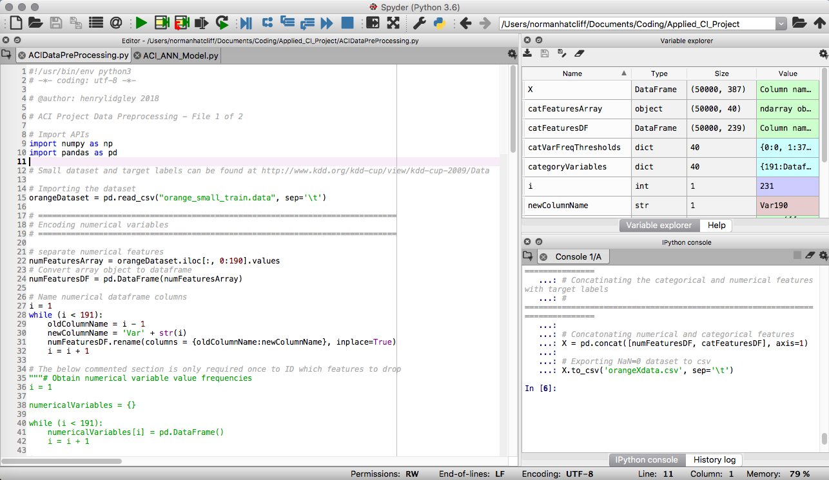
Neural Network Based Classifier Solution – Overview
HL
Recent progress in artificial neural networks (ANNs) has enabled the surpassing of other machine learning algorithm benchmarks in a wide variety of applications, including image and speech recognition, NLP and bioinformatics [5] [6] [7].
The neural networks developed for this project were coded using an Anaconda distribution of Python and the Spyder IDE. Anaconda is the self-professed ‘most popular Python data science platform’ [8].
Spyder is a Python IDE with good debugging and introspection features.
Table 4 – Classifier final prediction AUC scores
Example of Spyder IDE

Slide 15


Neural Network Based Classifier Solution – API Overview
HL
Open-source APIs used in the project include Keras [9], a high-level neural network API, written in Python and capable of running on top of TensorFlow [10], an API for numerical computation using data flow graphs.
TensorFlow was originally developed by members of the Google Brain team for their deep learning research. It functions as an open-source machine learning framework.
The Scikit-learn API [11] also features heavily, as it includes efficient data mining and analysis tools.
Finally, the Hyperopt [12] Python library facilitates hyperparameter search.
Table 4 – Classifier final prediction AUC scores
TensorFlow API (2015)
Keras API (2015)
Adam optimizer and its variants (2015)
Swish activation function (2017)

Slide 16
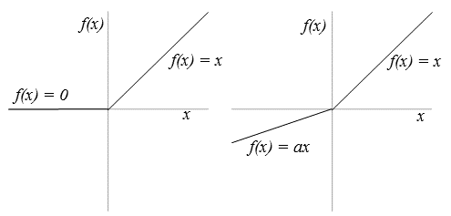
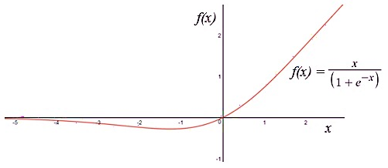
ANN Based Classifier Solution – Recent Activation Functions
Recently Developed/Adopted Activation Functions:
ReLU, a rectified linear unit [13], has become the most popular activation function in deep learning.
A variation of ReLU has been developed, called Leaky ReLU, which has a small and fixed negative gradient a, as shown below. Parametric Rectified Linear Unit (PReLU) takes this idea further by making a an adaptive parameter that can vary as the network is trained [14].
A team at Google Brain has used automatic search techniques, a combination of exhaustive and reinforcement learning-based search, to discover new activation functions [15]. Their best discovered activation function is fx= x ∙sigmoid(βx), which they name Swish. Its shape, though unique, is similar to ReLU, which makes it suitable for practitioners to replace ReLU with Swish in any neural network.
HL
Table 4 – Classifier final prediction AUC scores
ReLU and Leaky-ReLU/PReLU activation functions
The Swish activation function

Slide 17
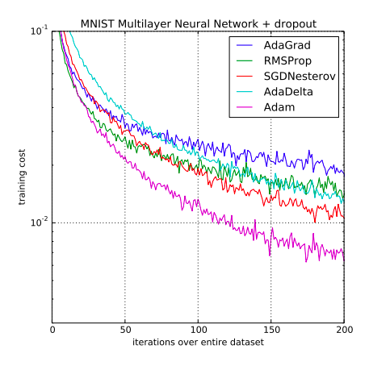
ANN Based Classifier Solution – Recent Optimizers
Recently Developed Optimizers:
HL
A recently developed (2014) optimization function is Adam [16].
Some of Adam’s advantages are that its step sizes are bounded by a step size hyperparameter, it works with sparse gradients (low computational cost), and it naturally performs a form of step size annealing [16].
Nadam is essentially Adam with Nesterov momentum.
Table 4 – Classifier final prediction AUC scores
Adam outperforming rivals on MNIST dataset

Slide 18
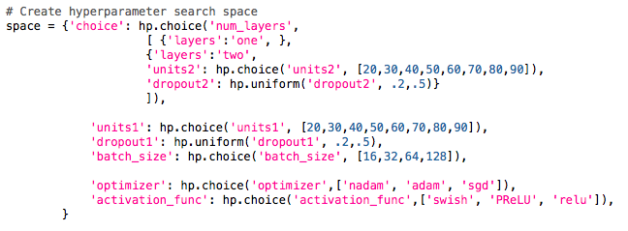
ANN Based Classifier Solution – Hyperparameter Search
Hyperopt Hyperparameter Search:
Number of hidden layers: 1,2 (Initially 2,3)
Number of hidden neurons: 20,30,40,50,60,70,80,90 (Initially 50-1100)
Activation functions: ReLU, PReLU and Swish
Optimizer: SGD with momentum and Nesterov accelerated momentum, Adam and Nadam.
Batch sizes: 16, 32, 64, and 128.
Dropout probability: Random uniform distribution [0.2,0.5].
Number of final evaluations: 40 for each target (but many more with earlier parameter ranges)
HL

Slide 19
Neural Network Based Classifier Solution – Other Considerations
Overfitting – early stopping and check points (based on validation accuracy)
Batch normalisation (relevant for linear rectifier activation functions)
Selection of loss function: Binary Cross Entropy (online AUC maximisation would be better)
Target class imbalance – weighting and oversampling (Churn: 7.34%; Appetency: 1.78%; Upselling: 7.36%)
Removing variables with no or little variance, and replacing missing values (mean and zero)
Transforming category variables to binary dummy variables (only numerical values)
Standardising numerical variables (necessary to reduce disparity in variance)
Principal Components Analysis considered but rejected (perhaps due to multicollinearity)
HL

Slide 20
Neural Network Based Classifier Solution - Results
HL
Best results:
Classifier: |  | Best params | Best params | Best params | Best variant*
Patience: |  | 20 | 50 | 200 | 200
Upselling | AUC | 0.8118 | 0.8166 | 0.8125 | 0.7806
 | Accuracy | 0.8234 | 0.8539 | 0.852 | 0.9298
 | Epochs | 28 | 101 | 350 | 325
Appetency | AUC | 0.7155 | 0.7355 | 0.7164 | 0.7197
 | Accuracy | 0.884 | 0.9704 | 0.9705 | 0.9797
 | Epochs | 31 | 90 | 250 | 292
Churn | AUC | 0.6891 | 0.6808 | 0.6681 | 0.6475
 | Accuracy | 0.7176 | 0.7326 | 0.8512 | 0.8889
 | Epochs | 68 | 95 | 480 | 928
AUC mean |  | 0.7404 | 0.7427 | 0.7323 | 0.7159
Best hyperparameters:
Params \ Classifier | Upselling | Appetency | Churn
Layers | 2 | 1 | 2
Units1 | 30 | 70 | 40
Units2 | 20 | Nil | 30
Drop Out1 | 0.4296 | 0.392 | 0.4991
Drop Out2 | 0. 4169 | N/A | 0.4354
Act. Func. | PReLU | Swish | PReLU
Opt. Func | Nadam | Nadam | Nadam
Batch Size | 16 | 16 | 16
Table 4 – Classifier final prediction AUC scores
* Best variant is a variant on the best params in which layers=2, units1=387 and units2=200

Slide 21
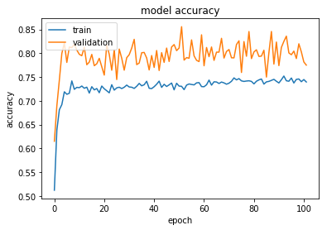
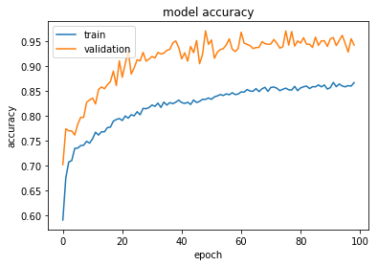
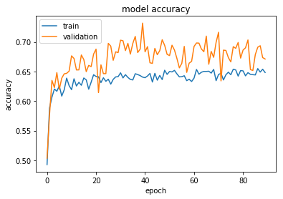
Neural Network Based Classifier Solution – Training Histories
HL
Table 4 – Classifier final prediction AUC scores
Upselling accuracy training history with 50 epoch patience.
Appetency accuracy training history with 50 epoch patience.
Churn accuracy training history with 50 epoch patience.

Slide 22
Neural Network Based Classifier Solution - Evaluation
Evaluation of results:
The best upselling AUC score is 0.8166, the best appetency AUC score is 0.7355, and the best churn AUC score is 0.6891, with a combined average of 0.7471.
As a benchmark, the challenge included AUC scores from a basic naïve bayes classifier for competitors to beat in order to qualify for a prize, with the overall AUC benchmark score being 0.6711.
77th position on the original KDD Cup 2009 slow track results list. In total, 7865 valid entries were submitted by 453 different teams.
Imbalanced target classes can cause problems. E.g.:
Lessons learned:
Always start with simplest architecture possible and build up. Incremental hyperparameter search for future research.
Time spent in data preparation is time well spent. Automated data cleaning for large, messy datasets for future research.
Online AUC maximisation in loss function for imbalanced target classes. Novel loss function for future research.
Ensemble models have good empirical basis. Utilise in future data mining project.
HL
Table 4 – Classifier final prediction AUC scores
Classifier: |  | Best params | Best params | Best params | Best variant*
Patience: |  | 20 | 50 | 200 | 200
Churn | AUC | 0.6891 | 0.6808 | 0.6681 | 0.6475
 | Accuracy | 0.7176 | 0.7326 | 0.8512 | 0.8889
 | Epochs | 68 | 95 | 480 | 928

Slide 23
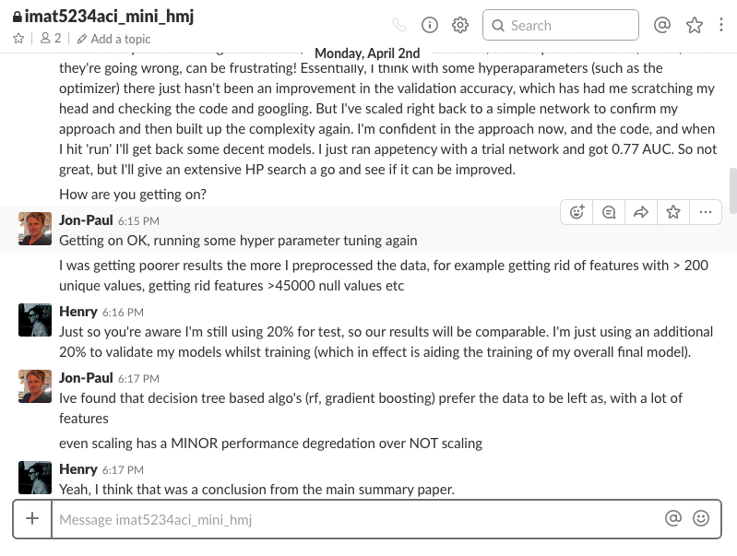

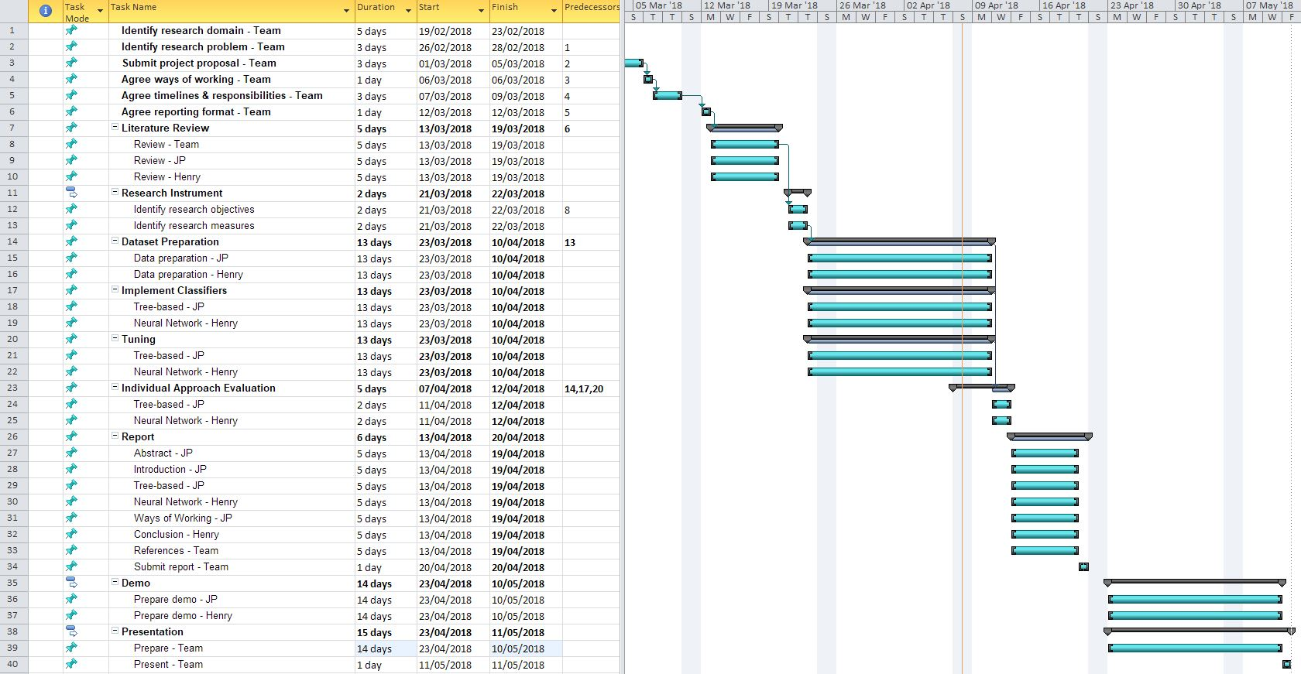

Ways of Working
Daily communication on Slack:
Bi-weekly calls on Skype:
Table 4 – Classifier final prediction AUC scores
Task tracker:
HL

Slide 24
Conclusions
Highest performing solution for the benchmarking 2009 KDD Cup Orange Challenge with the ‘small’ dataset was a gradient boosting classifier, with the following data pre-processing:
Missing numerical values imputed with an arbitrary -9876 value
Missing categorical values imputed with ‘missing’
Creation of categorical binary dummy variables
No pre-training normalization
In descending order of AUC score performance, the other solutions were:
Voting classifier > Bagging > Random forest > Decision trees > AdaBoost > Neural networks.
Winning team from IBM Research used a library of 500-1000 classifiers to generate ensemble models.
Both authors are new to the APIs used (one to Python entirely) and the vast majority of methods employed in this project.
As a learning experience, we both agree that it has been an extremely beneficial undertaking to have collaborated on.
HL

Slide 25
References
[1] I. Guyon, V. Lemaire, M. Boullé, G. Dror and D. Vogel, “Design and analysis of the KDD cup 2009: fast scoring on a large orange customer database,” ACM SIGKDD Explorations Newsletter, vol. 11, no. 2, pp. 68-76, 2009.
[2] G. L. a. M. Berry, Data Mining Techniques, 3rd Edition ed., Indianapolis, IN: Wiley, 2011
[3] C. Ferri, P. A. Flach and J. Hernández-Orallo, “Improving the AUC of Probabilistic Estimation Trees,” in European Conference on Machine Learning, 2003
[4] Y. Freund and R. E. Schapire, “A Short Introduction to Boosting,” Journal of Japanese Society for Artificial Intelligence, vol. 14, no. 5, pp. 771-780, 1999
[5] W. Liu et al., “A survey of deep neural network architectures and their applications,” Neurocomputing, vol. 234, no. 11–26, December 2016.
[6] Z. Tang e. al, “A joint residual network with paired ReLUs activation for image super-resolution,” Neurocomputing, no. 273, pp. 37-46, 2018.
[7] Y. LeCun et al., “Deep Learning,” Nature (London), no. 7553, pp. 436-444., May 2015.
[8] “Anaconda”, [Online]. Available: https://www.anaconda.com/
[9] F. Chollet, “Keras,” GitHub Repository, [Online]. Available: https://github.com/keras-team/keras.
[10] M. Abadi et al., “TensorFlow,” 2015. [Online]. Available: www.tensorflow.org.
[11] “Scikit-learn,org,” [Online]. Available: http://scikit-learn.org/stable/
[12] “Hyperopt”, [Online]. Available: http://hyperopt.github.io/hyperopt/
[13] A. Kirzhevsky et al., “ImageNet Classification with Deep Convolutional Neural Networks,”
[14] “PReLU,” [Online]. Available: https://arxiv.org/pdf/1502.01852.pdf. in NIPS, 2012.
[15] P. Ramachandran et al., “Swish: A Self-Gated Activation Function,” Google Brain Residency program, 2017. [Online]. Available: https://arxiv.org/pdf/1710.05941.pdf
[16] D. Kingma. et al., “Adam: A Method for Stochastic Optimization,” in International Conference on Learning Representations, 2014.
[17] E. Tav et al., “Feature Selection with Ensembles, Artificial Variables, and Redundancy Elimination,” Journal of Machine Learning Research, vol. 10, pp. 1341-1366, 2009
[18] J. H. Freidman, “Greedy Function Approximation: A Gradient Boosting Machine,” in IMS 1999 Reitz Lecture, 1999

